Slide 1
Repositioning task in Markov Decision Process

Slide 2


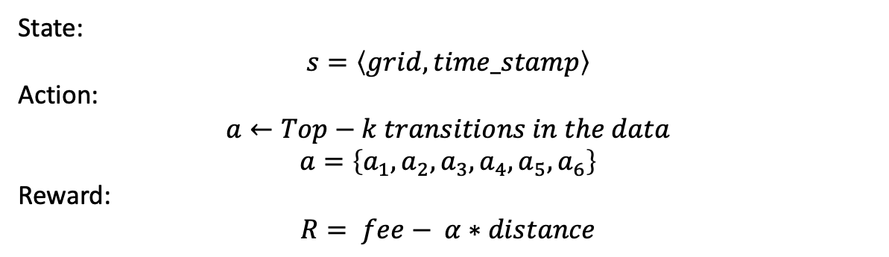



$$a_{5}$$
State:
$$s=\left\langle grid,time_stamp\right\rangle$$
Action:
$$a←Top−k transitions in the data$$
$$a=\left\{a_{1},a_{2},a_{3},a_{4},a_{5},a_{6}\right\}$$
Reward:
$$R= fee− α∗distance$$
$$a_{3}$$
$$a_{2}$$
$$a_{1}$$
$$a_{4}$$

Slide 3
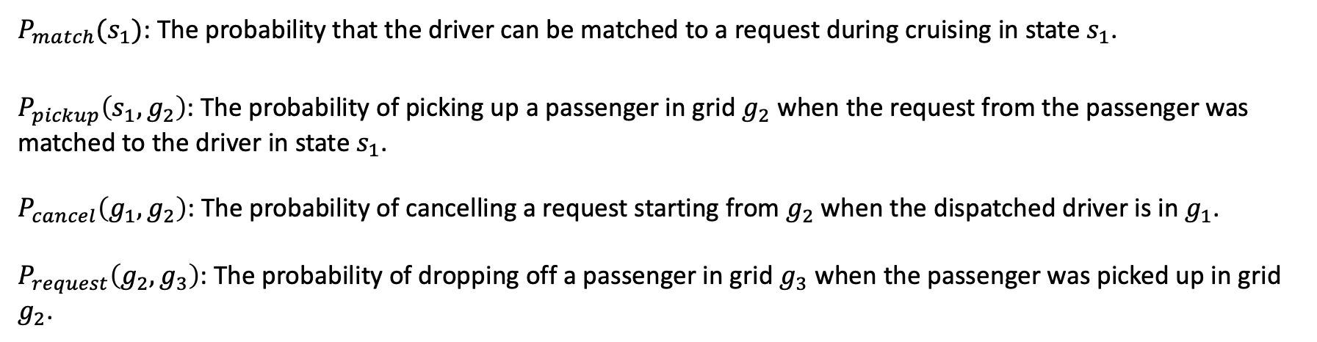
$P_{match}(s_{1})$: The probability that the driver can be matched to a request during cruising in state $s_{1}$.
$P_{pickup}\left(s_{1},g_{2}\right)$: The probability of picking up a passenger in grid $g_{2}$ when the request from the passenger was matched to the driver in state $s_{1}$.
$P_{cancel}\left(g_{1},g_{2}\right)$: The probability of cancelling a request starting from $g_{2}$when the dispatched driver is in $g_{1}$.
$P_{request}\left(g_{2},g_{3}\right)$: The probability of dropping off a passenger in grid $g_{3}$ when the passenger was picked up in grid $g_{2}$.

Slide 4






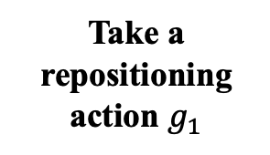

$$P_{pickup}\left(s_{1},g_{2}\right)∗\left(1−P_{cancel}\left(g_{1},g_{2}\right)\right)∗P_{request}\left(g_{2},g_{3}\right)$$
$$s_{3}=\left\langle g_{3},t_{0}+tt\left(g_{0},g_{1}\right)+tt\left(g_{1},g_{2}\right)+tt(g_{2},g_{3})\right\rangle$$
$$P_{match}(s_{1})$$
$$s_{1}=\left\langle g_{1},t_{0}+tt\left(g_{0},g_{1}\right)\right\rangle$$
Take a repositioning action $g_{1}$
$$s_{2}=\left\langle g_{2},t_{0}+tt\left(g_{0},g_{1}\right)+tt\left(g_{1},g_{2}\right)\right\rangle$$
$$P_{pickup}\left(s_{1},g_{2}\right)∗P_{cancel}\left(g_{1},g_{2}\right)$$
$$s_{0}=\left\langle g_{0},t_{0}\right\rangle$$
$$s_{1}=\left\langle g_{1},t_{0}+tt\left(g_{0},g_{1}\right)\right\rangle$$
$${1−P}_{match}(s_{1})$$

